Slide 1

ASTR 288P
UNIX and Scientific Programming with Applications in Astrophysics
Course Outline
Fall 2018
Constantinos Kalapotharakos
UMCP, NASA GSFC
University of
Maryland

Slide 2
About Me
Constantinos Kalapotharakos
constantinos.kalapotharakos@nasa.gov
ckalapotharakos@gmail.com
ckalapotharakos@astro.umd.edu
Use these two (both)
Based at NASA GSFC (so regularly off campus)
You can meet me:
ATL 1243, Fri 1-2pm (before class)
Always Confirm
Additional times can be set up by email if needed
Course Website
https://github.com/ckalapot/astr288p_fall_2018

Slide 3
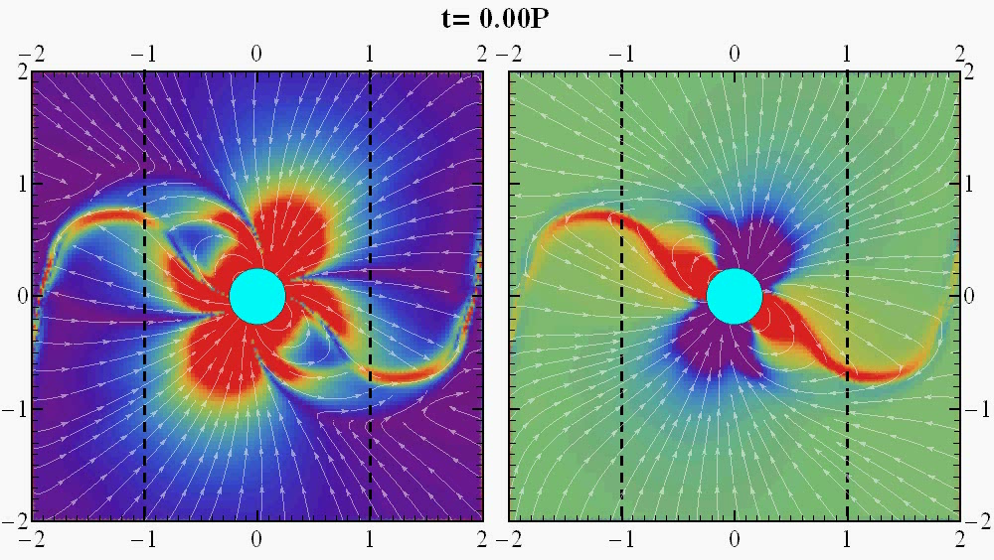
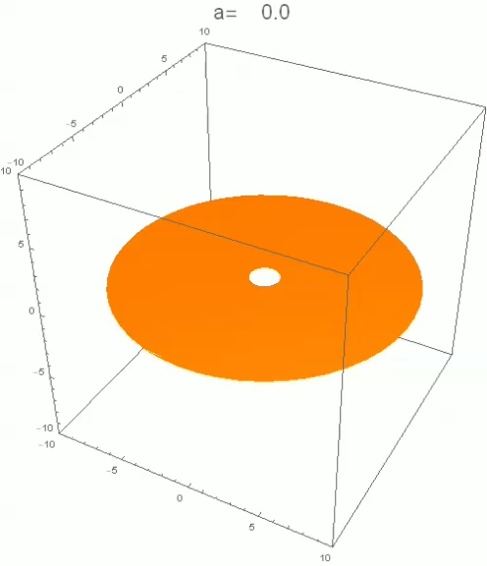
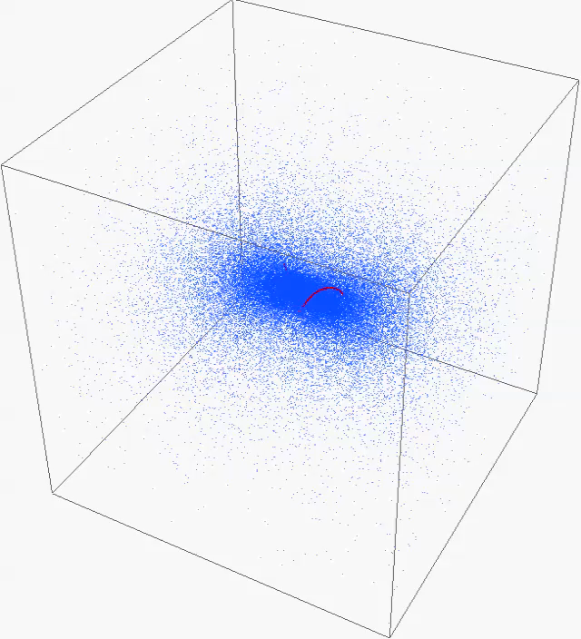
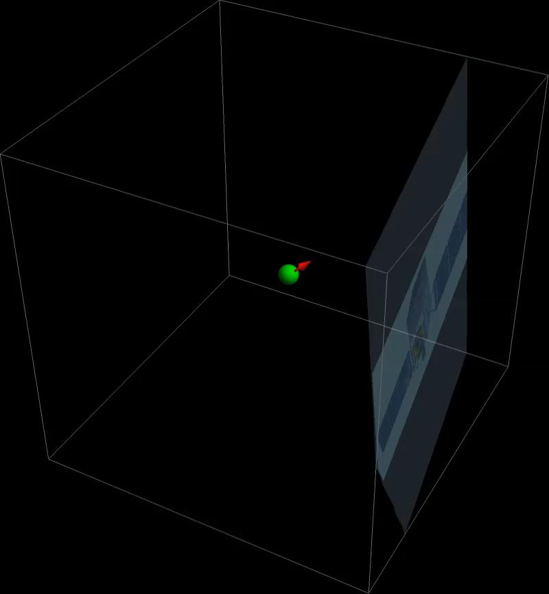
About Me
High Energy Astrophysics
(Pulsars, Compact Objects)
Galactic Dynamics
(Chaos, Secular Evolution)
N-body code
MHD Force-Free code
Developer
Computational Astrophysicist
Fortran, C, MPI
Mathematica, Python
Particle-in-cell (PIC) code (C-3PA)

Slide 4
Syllabus
Students will be introduced to the UNIX environment and especially to scientific programming (mainly in Python). Students will learn how to operate within a UNIX environment (e.g. Linux, macOS), run commands, and write scripts in Bash shell.
After successfully completing this course you will be able to:
Work within UNIX environment
Write shell scripts
Code in Python
Analyze and visualize scientific data
Students will learn the fundamentals of computer programming while emphasis will be given to numerical methods, visualization techniques, and astrophysical applications. Students will also be made comfortable installing and using open source software, which includes collaborating and sharing their own code.

Slide 5
What will be covered
Unix
Shells (e.g bash)
File system (/, /etc, $HOME)
Basic commands and shell scripting
Editors (e.g. emacs, atom, VSCode)
Tools (e.g. git, c and fortran compilers -> open source software)
Scientific Programming (python, ipython, jupyter)
Fundamentals of programming (e.g. variables, lists, arrays, structures, functions)
Numerical methods (e.g. root finding, fitting, numerical integration, integration of differential equations)
Data analysis
Data visualization (plotting, 2D, 3D, animations)
(Astro)physical applications
(Astro)physical project

Slide 6
Course Format - Grades
Grades
Lectures in almost every class
10%
In-class experimentation and exercises
Homework (due before each class through submission to ursa)
20%
Formal assessments (~15mins)
open notes, known dates (no surprises)
20%
Project (among a list of available projects or one of your own) and presentation instead of a final written exam
50%

Slide 7
Course Format - Grades
Lectures in almost every class
10%
In-class experimentation and exercises
Homework (due before each class through submission to ursa)
20%
Formal assessments (~15mins)
open notes, known dates (no surprises)
20%
Project (among a list of available projects or one of your own) and presentation instead of a final written exam
50%

Slide 8
Resources
Not a specific textbook
Internet, Google (plethora of information)
Just a few…
http://www.ee.surrey.ac.uk/Teaching/Unix/ (unix)
http://www.stackoverflow.com (any kind)
https://www.tutorialspoint.com (unix, python…)
https://docs.python.org/3/ (python)
https://www.scipy.org/index.html (python)
https://www.scipy-lectures.org/intro/index.html (python)
The course website will be updated regularly.

Slide 9
Hardware
Lab machines
Master: ursa.astro.umd.edu
Nodes: lab001, lab002,…, lab013
Printer: labs.astro.umd.edu
Your own machine (laptop, desktop)
Linux (Ubuntu, Redhat,…)
MacOS (Be aware to have Xquartz installed so “ssh -X” works!)
Windows (win10 bash and/or ubuntu).
Putty or CygwinX to make ssh connections
For X11, you need to install an X-server (e.g. Xming)
Virtual machines (e.g. virtualbox, vmware)

Slide 10
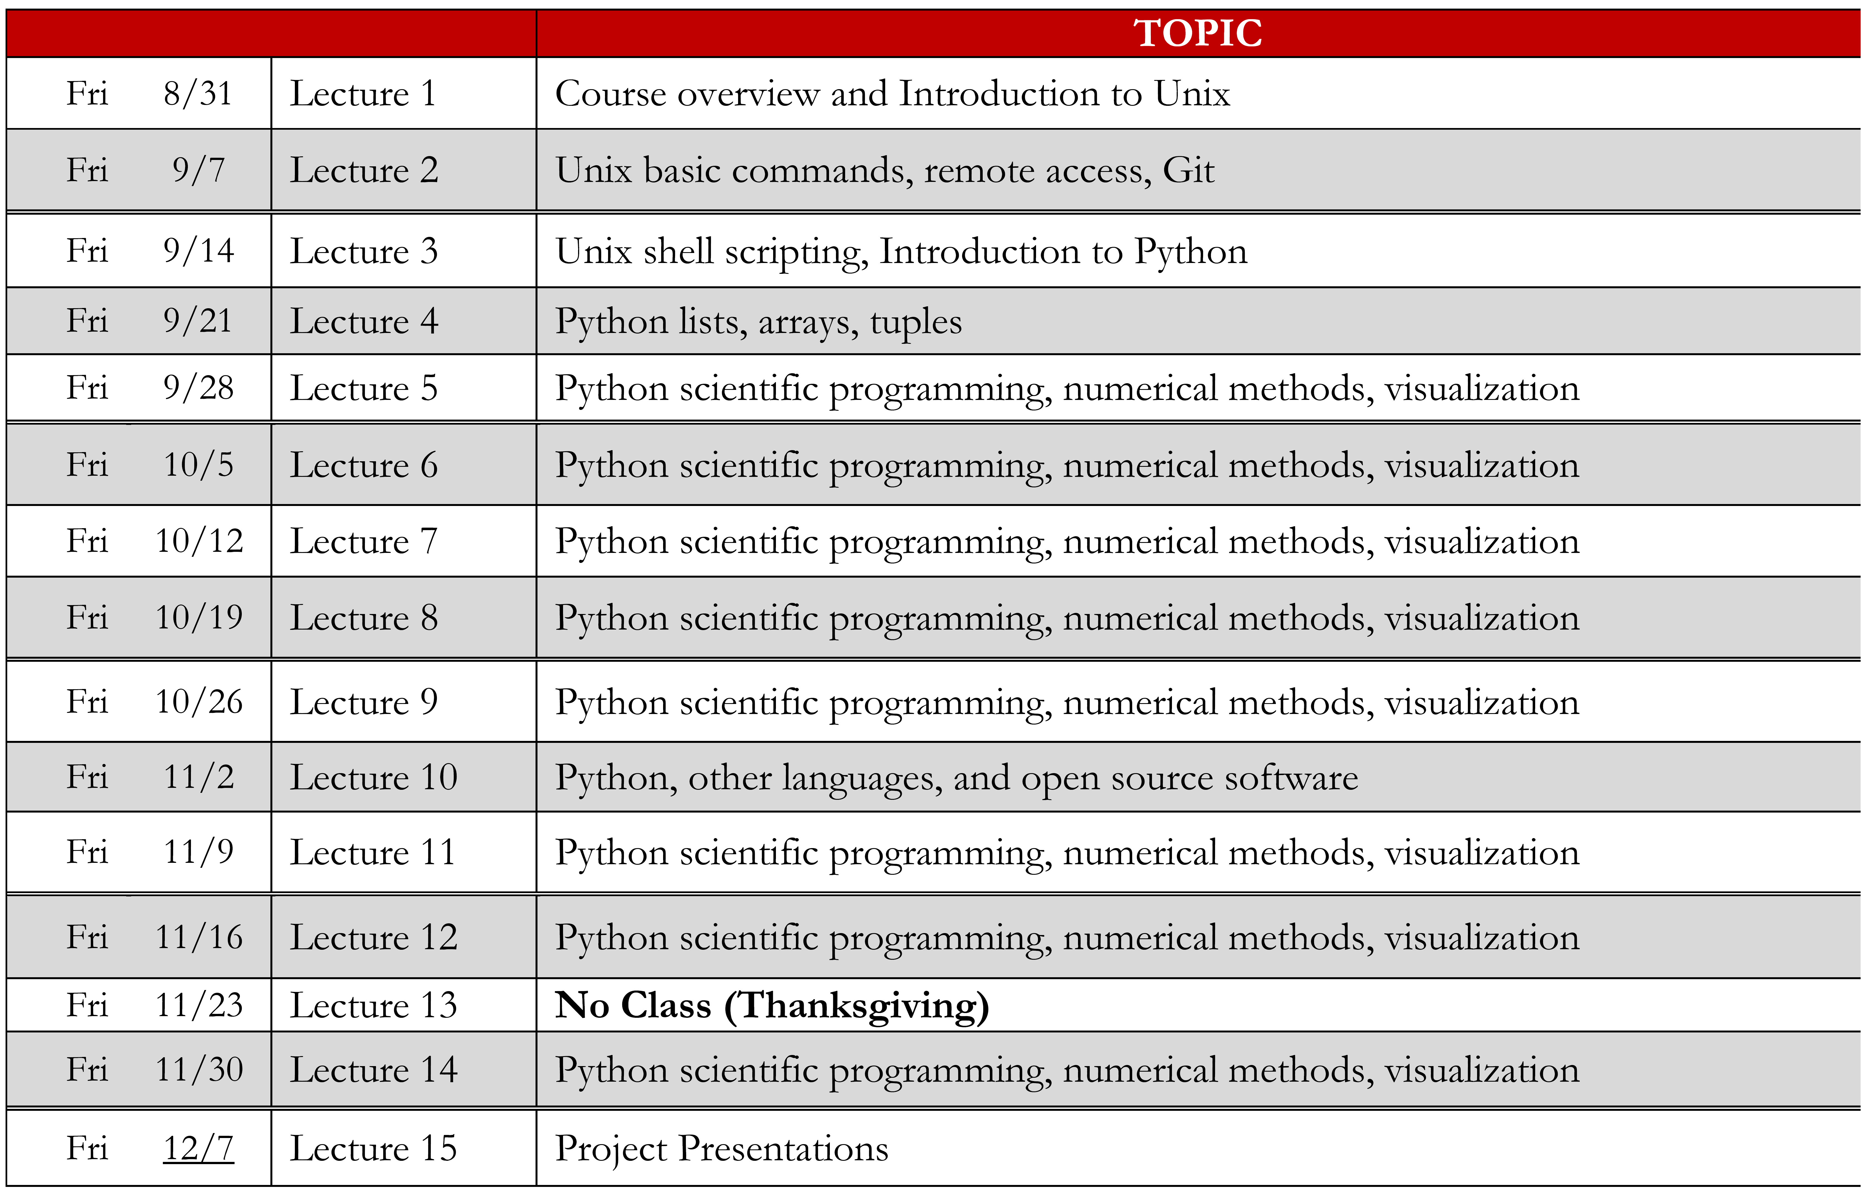
Course Schedule (tentative)

